Slide 1

Digital Forensics
Best MDM Solution for Digital Forensics Reporting & Support
Notes:
Hello, welcome to my presentation. This week, I will be focusing on the best MDM solutions for Digital Forensics, an important topic for CMMC and NIST compliance.

Slide 2
Agenda
Questions To Answer
What is Digital Forensics/Why is it Needed
IBM QRadar Incident Forensics
Citrix XenServer Forensics
Microsoft Intune/O365 Security Incident Forensics
Meraki Systems Endpoint Manager
VMware Workspace One
AWS Digital Forensics
Comparison
Questions/Concerns
Next Week’s Presentation ideas
Notes:
For the agenda today I will cover questions that I will answer helping me evaluate the six MDM software’s digital forensic capabilities. I will also explain what is the purpose of digital forensics and how it relates to CMMC and NIST compliance. I will conclude the presentation with my comparison and my questions/concerns. Most importantly, I will explain my next weeks presentation ideas.

Slide 3

Questions To Answer
Notes:
I have some questions that I will answer by evaluating each of the six MDM solutions. First, which platform has the best digital forensics workspace. Why is that specific platform the best, what are the characteristics that makes it stand out. How does digital forensics relate to NIST and CMMC.

Slide 4
Digital Forensics
What is Digital Forensice
Why Does Digital Forensics Matter
NIST & CMMC in Digital Forensics
Notes:
First, what is digital forensics? According to NIST, digital forensics otherwise known as, “Digital evidence includes data on computers and mobile devices, including audio, video, and image files as well as software and hardware. Digital evidence can be a part of investigating most crimes, since material relevant to the crime may be recorded in digital form. Methods for securely acquiring, storing and analyzing digital evidence quickly and efficiently are critical” (NIST, n.d). Simply, digital forensics is paramount for data recovery and incident response. Digital Forensics allows a companies SOC to quickly and efficiently pivot from a successful data breach by containing evidence for further evaluation. Once the source of the breach is identified, a patch can be made. Also, Digital Forensics is extremely important in CMMC and NIST. It makes an appearance in the Audit and Accountability section of CMMC, and it is talked about NIST as well.

Slide 5
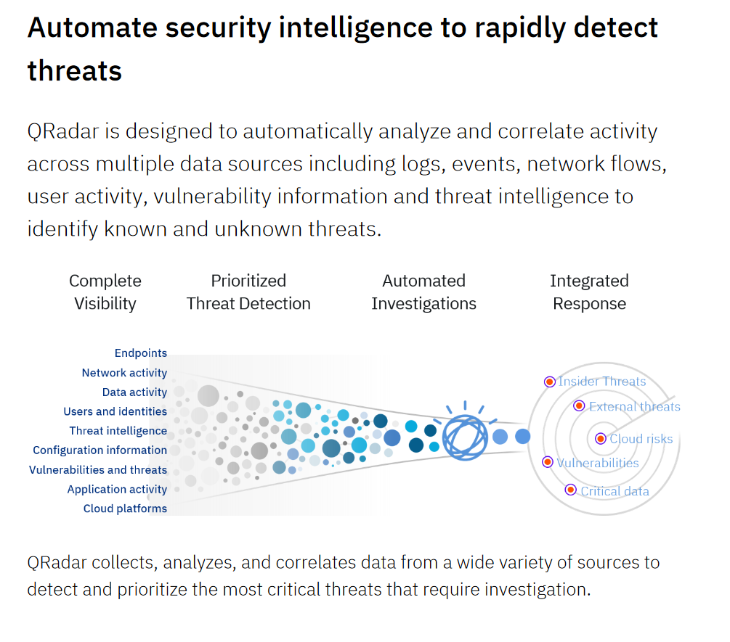
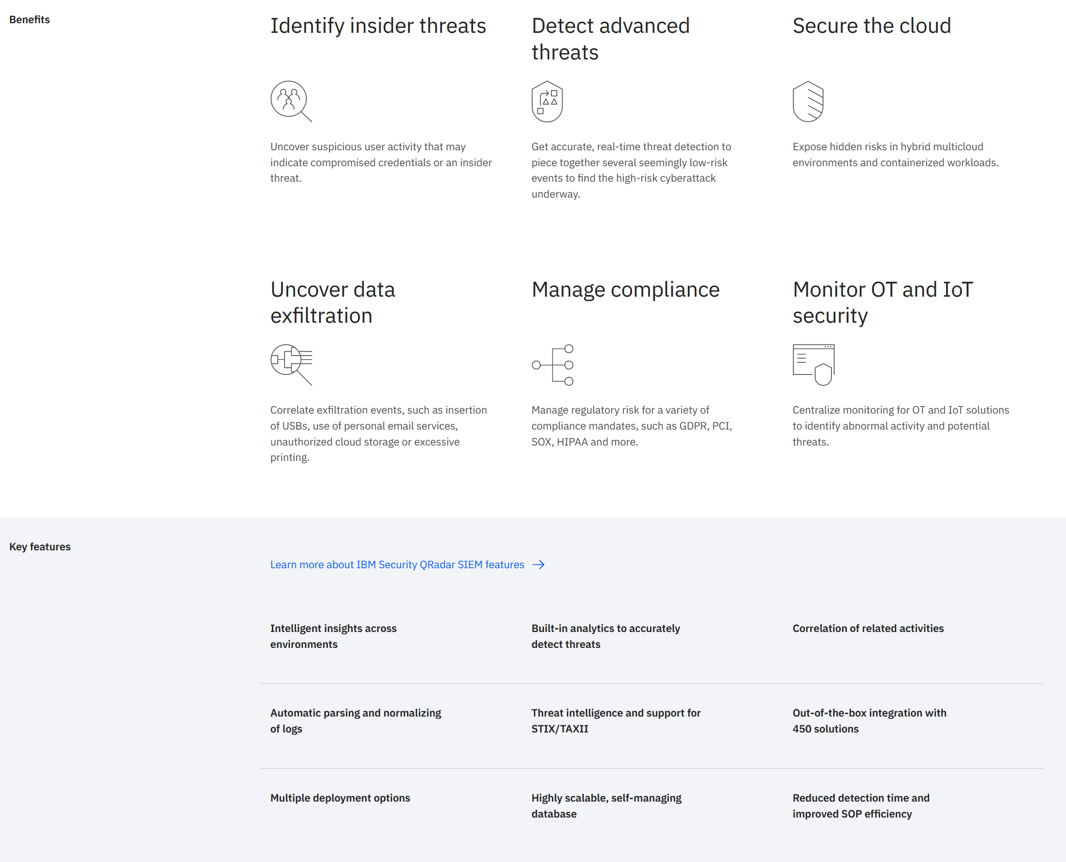
IBM QRadar Incident Forensics
Insider Threats
Cloud Risks
Vulnerabilities
Critical Threats (APTs)/Data
External Threats
Open Architecture
Notes:
IBM’s QRadar Incident Forensics is an amazing start. QRadar intelligently analyzes activity across enrolled devices and automatically correlates this data together cleanly. Exceptionally clean and correlated data will provide SOC teams, known as Security Operations Center teams, a big picture understanding of threats/breaches. IBM’s approach is to have their product automatically investigate possible suspicious behavior. In turn, IBM’s QRadar can detect insider threats and APTs (Advances Persistent Threats). QRadar uses Machine Learning to normalize and provide intelligent insights on threats providing, “out-of-the-box integration with 450 solutions” (IBM, n.d). QRadar even protects/logs multicloud environments where it is exceptionally hard to preform digital forensics. QRadar also has a section for managing compliance, this makes sure that companies implement CMMC and NIST requirements and stay up-to-date with HIPPA/SOX laws.

Slide 6
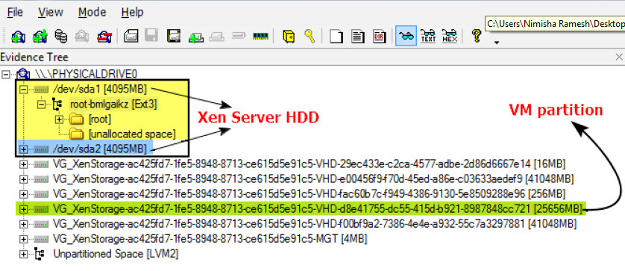
Citrix XenServer Forensics
Clone Evidence
Examine Image Artifact
Spotting Virtual Partitions
Backup Partitions
Notes:
Citrix XenServer Forensics is interesting. Specifically, XenServer Forensics is, “the high-performance hypervisor optimized for virtual app and desktop workloads and based on the Xen Project hypervisor, is now Citrix Hypervisor” (Citrix, n.d). However, a key drawback for Citrix is that digital forensics can only be achieved through their XenServer platform. XenServer does not appear to log and monitor/integrate with any apps or third-party apps. This platform can only log and monitor the actual HDD/SDD of a production server. Digging deeper into my research, I found another product Citrix offers, it is called NetScaler. It unfortunately is limited with reporting and logging and the cost is off the charts, “a single Citrix ADC VPX 10 Mbps Standard Edition costs $2,440—a VPX 1000 Mbps Standard Edition costs $18,300. A 3000 Mbps VPX Premium Edition costs $43,920” (Yfantis, 2019). Stay away from Citrix at all costs!

Slide 7
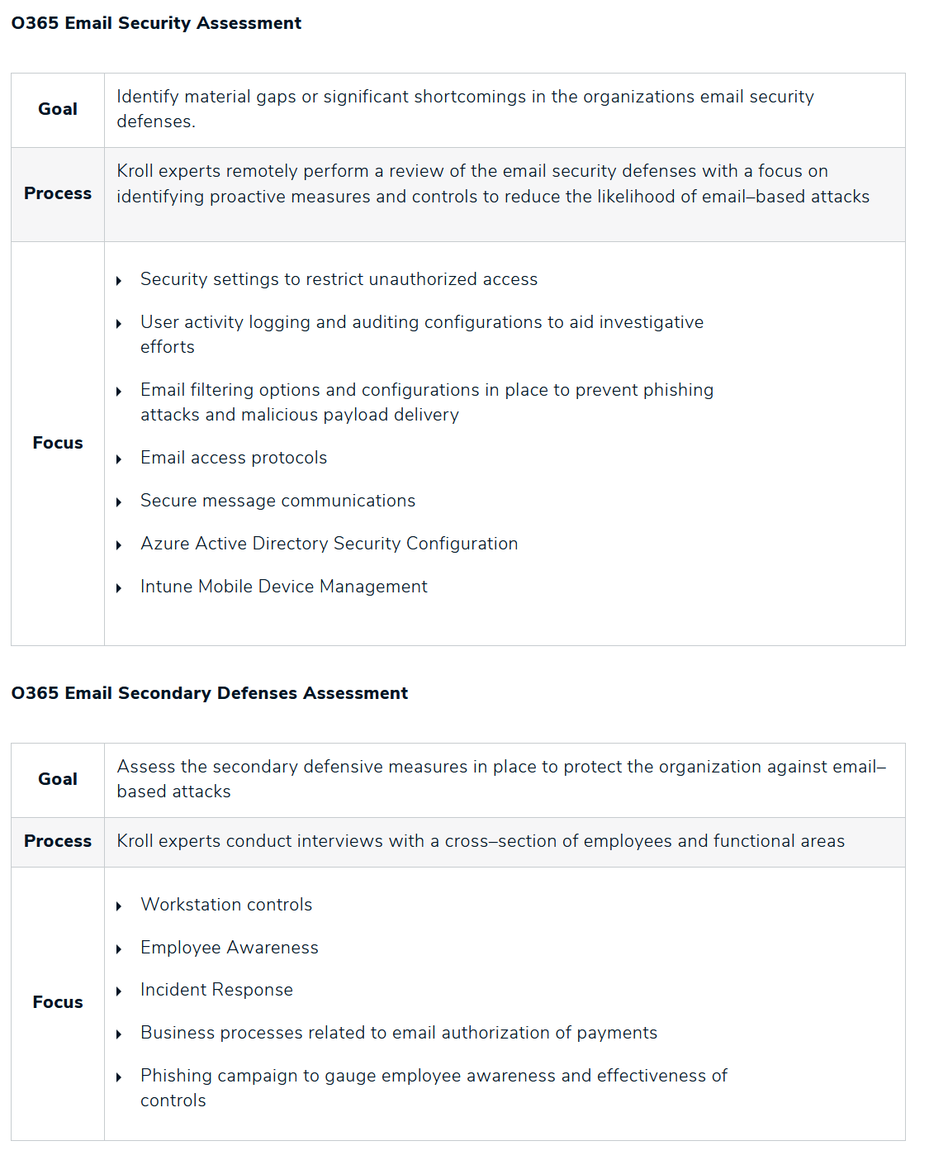
Microsoft Intune/O365 Security Incident Forensics
Email
Virtual Services
One Drive
Sharepoint
Notes:
Microsoft Intune/Azure offers comprehensive digital forensics for mail clients and web browser–based access, OneDrive and SharePoint file access and even their virtual services present on Azure such as their VPSs and databases. SOC teams can preform digital forensics with ease because, “the SOC team has exclusive access to a different Azure SOC subscription, for resources that must be kept protected, unviolated, and monitored. The Azure Storage account in the SOC subscription hosts copies of disk snapshots in immutable Blob Storage and keeps the snapshots' SHA-256 hash values and copies of the VMs' BEKs and KEKs in its own SOC key vault” (IBM, n.d). This means that all devices that can login to a Microsoft account can be logged and monitored. Again, Microsoft has brought the best, it can protect almost every device, and it can log everything about those devices for later evaluation. However, thus far, does this solution beat IBM’s QRadar?

Slide 8
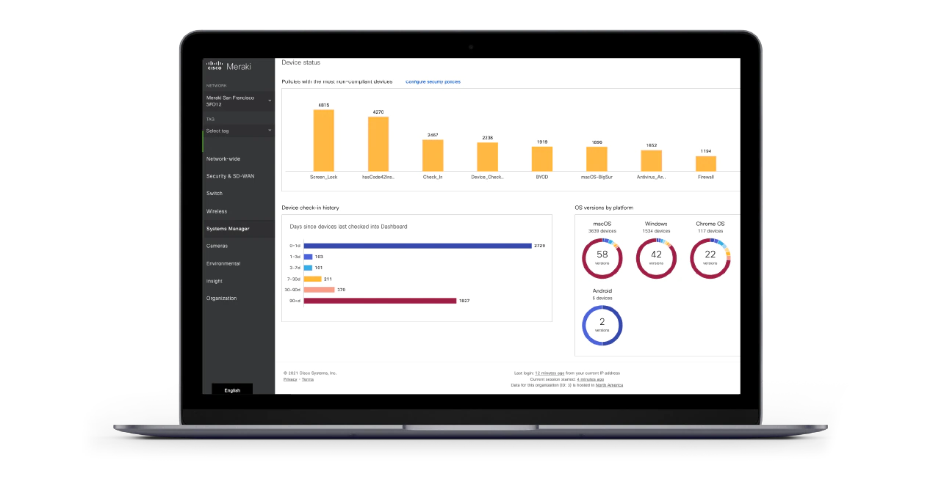
Meraki Systems Endpoint Manager
Automation
Control Access
Endpoint Management
Notes:
Unfortunately, likewise with my last presentation, Meraki Systems Endpoint Manager is just as terrible and Citrix. Through all my research I have not been able to locate any substantial evidence that Meraki even has a special section for digital forensics integration. This MDM is certainly disappointing. Although Meraki has exceptional integration with automation, this is not an MDM solution where quick pivotal data breaches are possible.

Slide 9
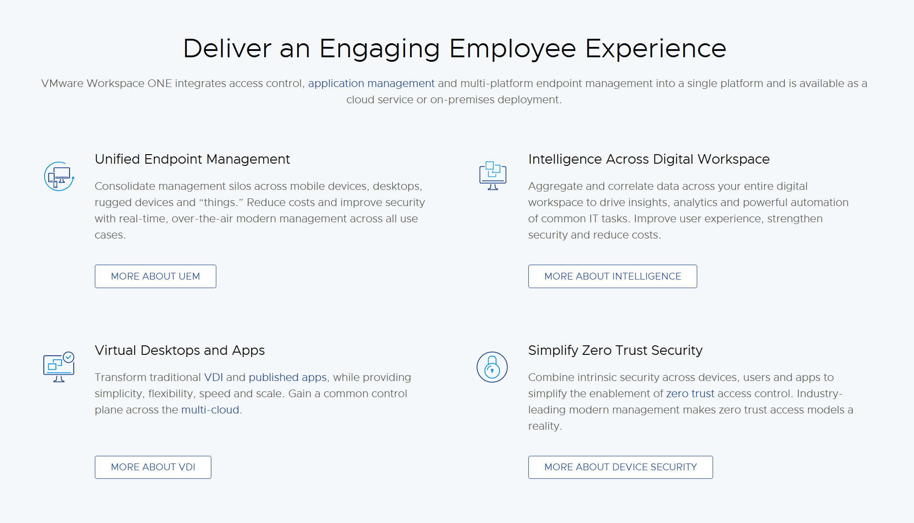
VMware Workspace One
Unified Endpoint Monitoring
Intelligence Across Workspaces
Zero Trust
Virtual Desktops and Apps
Notes:
VMware Workspace ONE is looking very promising. Not only does VMWare use ML algorithms to correlate and aggregate data across platforms the product integrates with virtual desktops and apps. VMware can even, “aggregate threat data from external sources like CVE lists and Workspace ONE Trust Network” (VMware, n.d). Moreover, VMware implements a Zero Trust security policy meaning that no single device is allowed to trust another device. All devices must interact the same without any privilege to one device or the other.

Slide 10
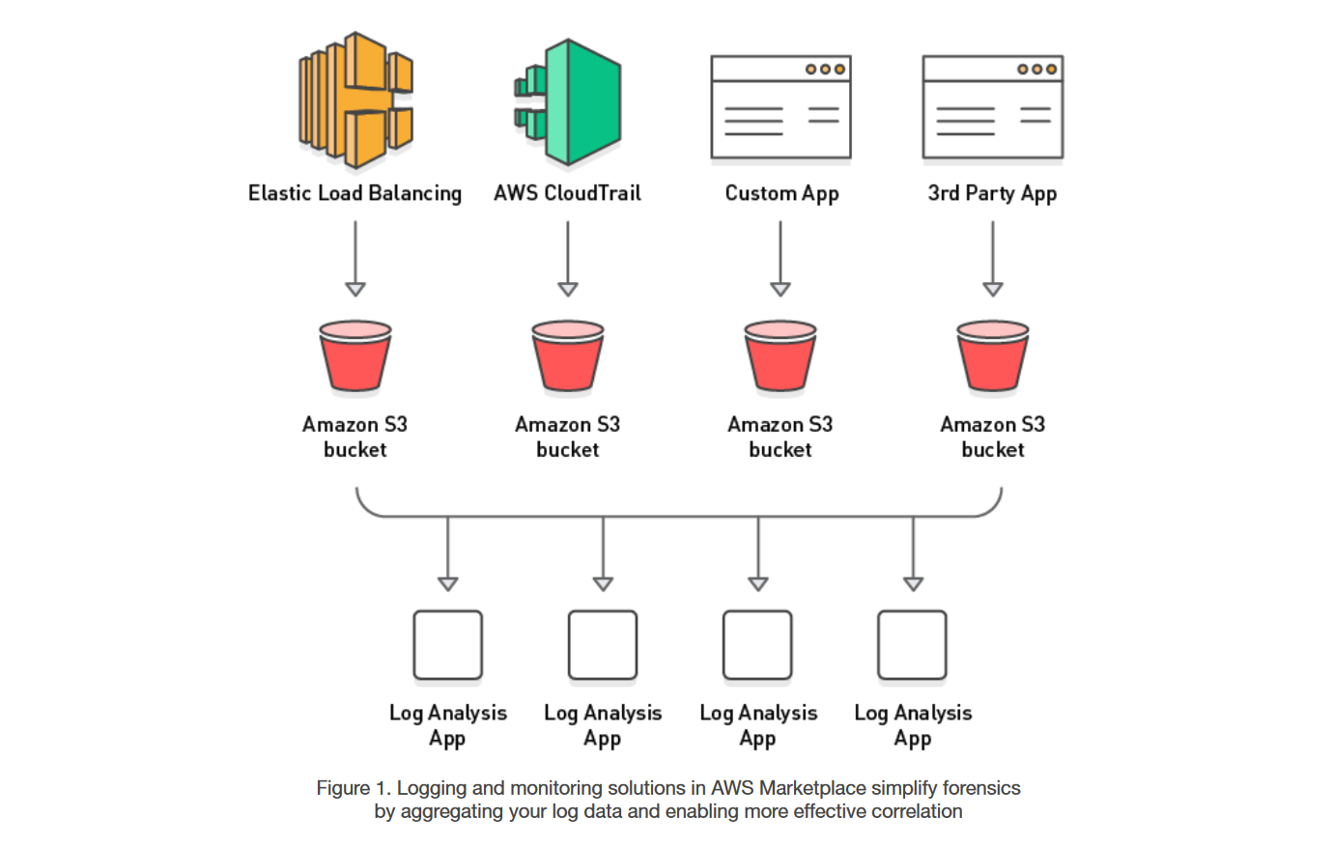
AWS Digital Forensics
Third Part Logging
Custom Apps
All Elastic Compute Servers
Notes:
I was extraordinarily happy to see that AWS Digital Forensics includes 3’rd party apps into their log analysis. However, AWS does not have automatic machine learning incident response. This clearly sets AWS below IBM’s QRadar and Microsoft Intune’s O365/Azure products. While AWS gives SOC teams extreme amounts of information as referenced from their picture to the right, there is not a great mechanism to sift through that data. If AWS could use intelligent ML algorithms to help SOC teams home in on unusual behavior/APTs then I could make a compelling argument for AWS.

Slide 11
Comparison
MDM Solution
Machine Learning
Aggregation/Correlation
Cloud Risks
Zero Day Support
Compliance
Microsoft O365/Azure
VMware Workspace ONE
IBM QRadar
Notes:
IBM is the clear winner! Not only does IBM QRadar implement Machine learning, cloud risk monitoring, and easy aggregation/correlation of threats to help with digital forensics, IBM has a compliance center. This center is tasked with making sure HIPPA, NIST, and CMMC standards are implemented and up-to-date! IBM fiercely fended off its completion and advanced to the top spot.

Slide 12
Next Week
Ideas?
Notes:
For next weeks presentation, I would like to focus on…

Slide 13
References
Citrix Xenserver. Citrix XenServer | XenServer. (n.d.). Retrieved July 18, 2022, from https://docs.citrix.com/en-us/xenserver.html
Detecting and responding to security issues in your AWS environment. (n.d.). Retrieved July 18, 2022, from https://d1.awsstatic.com/Marketplace/scenarios/security/SEC_11_TSB_Final.pdf
Hickman, J. (2014). MP: Manhattan projects. Amazon. Retrieved July 18, 2022, from https://aws.amazon.com/mp/scenarios/security/forensics/
IBM security QRadar Siem - overview. IBM. (n.d.). Retrieved July 18, 2022, from https://www.ibm.com/qradar/security-qradar-siem
Mobile Device Management (MDM): Systems manager. Cisco Meraki. (2022, June 15). Retrieved July 18, 2022, from https://meraki.cisco.com/products/systems-manager/
Office 365 security forensics and incident response: Cyber risk services. Kroll. (n.d.). Retrieved July 18, 2022, from https://www.kroll.com/en/services/cyber-risk/incident-response-litigation-support/office-365-security-forensics
Simonesavi. (n.d.). Computer forensics chain of custody in Azure - azure example scenarios. Azure Example Scenarios | Microsoft Docs. Retrieved July 18, 2022, from https://docs.microsoft.com/en-us/azure/architecture/example-scenario/forensics/
Workspace ONE Intelligence. VMware. (2022, July 14). Retrieved July 18, 2022, from https://www.vmware.com/products/workspace-one/intelligence.html
Yfantis, V. (2022, January 19). Citrix Netscaler: What is it?: Parallels insights. Parallels Remote Application Server Blog - Application virtualization, mobility and VDI. Retrieved July 18, 2022, from https://www.parallels.com/blogs/ras/citrix-netscaler/

